Slide 1
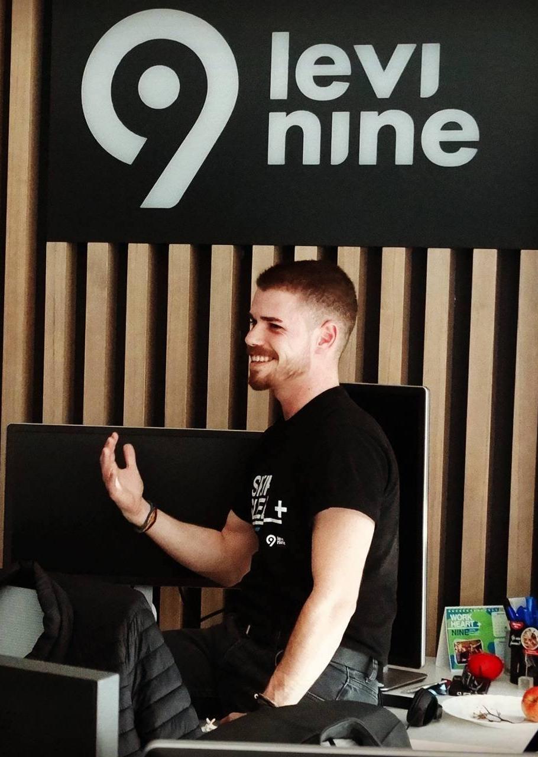
REAL-TIME GRAPHQL
Building real-time apps using React and GraphQL
Lucian Costin Ailenei
Tech9 Meet-up @ FabLab Iasi, 27 nov 2017

Slide 2
Contents
01
Real-time apps overview
02
Available state-of-the-art techniques; Where does GraphQL fit in?
03
How we can use GraphQL subscriptions to power real-time apps

Slide 3
Contents
04
Conclusions
05
05
Short Recap
06
Disclaimer & References
Q&A Session

Slide 4
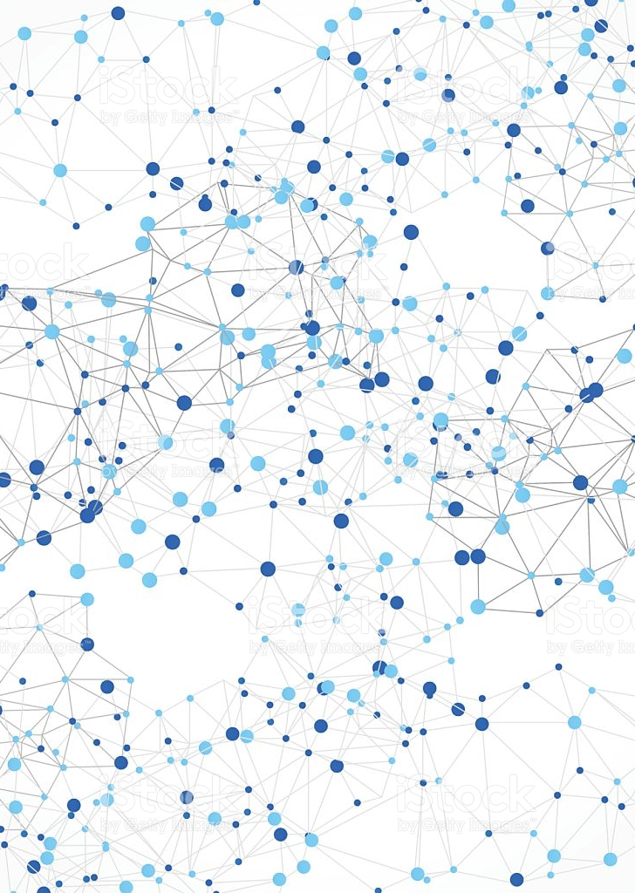
Real-time web apps Overview
01
What are them ? Why do we need them ? What are the benefits from the UX point of view ?

Slide 5
What are real-time apps ?
Web/Native/Desktop Applications which enable the user to receive information as soon as it is published by the server
It is not necessary to periodically check the server for updates

Slide 6
What ABOUT UX ?
Instant interaction
Sense of presence, connection, transparency
More engagement
User feels the moment, the event, the people, the world

Slide 7

Let’s see some examples

Slide 8
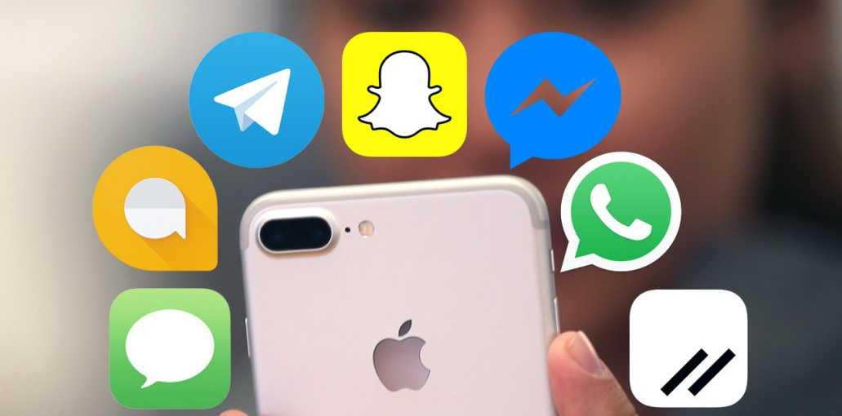

Slide 9
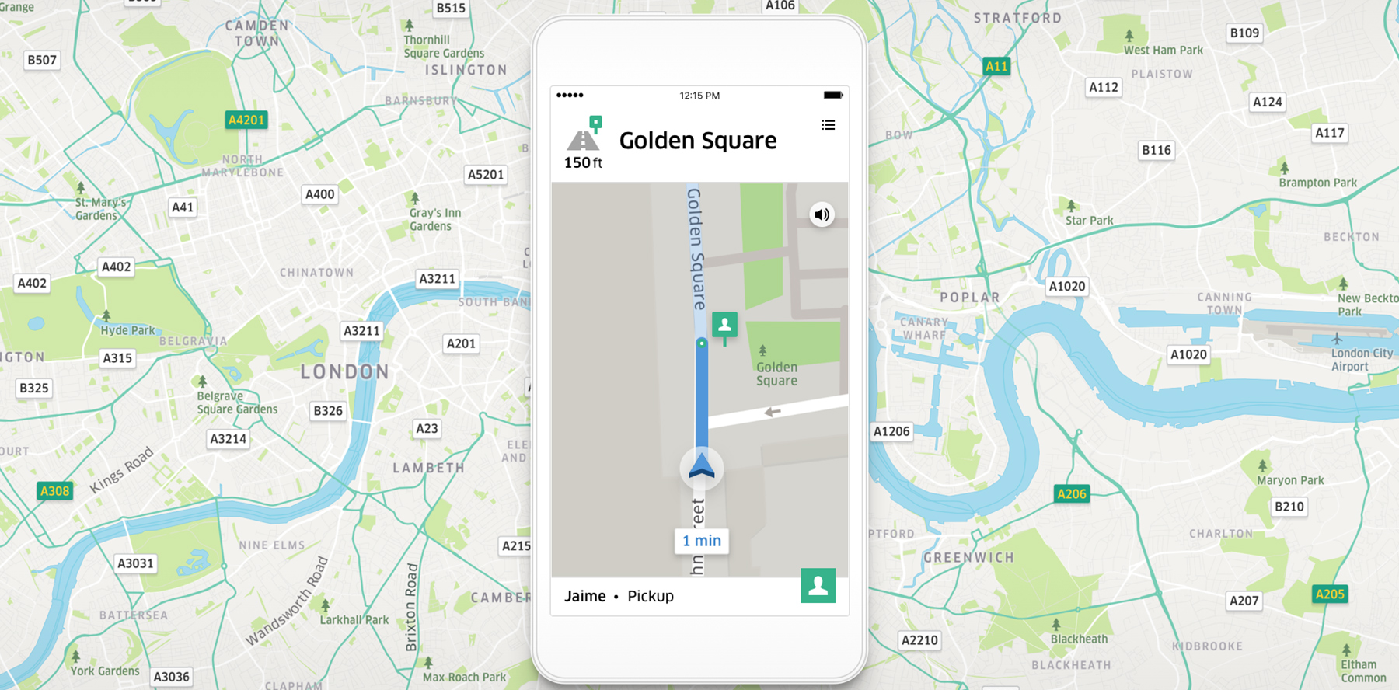

Slide 10
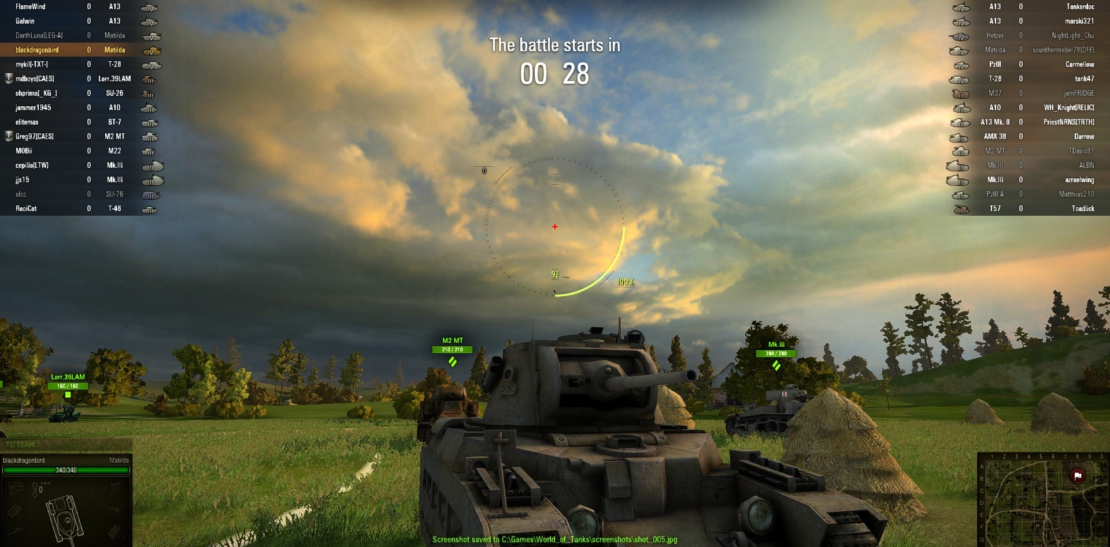

Slide 11
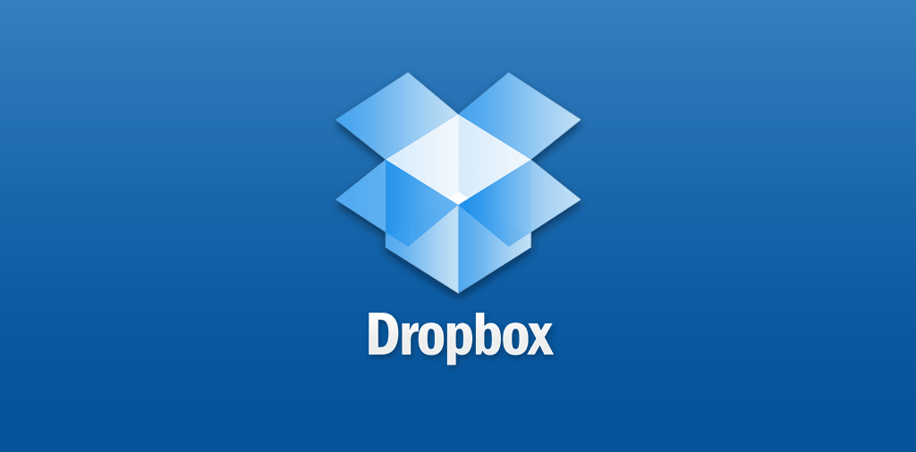

Slide 12
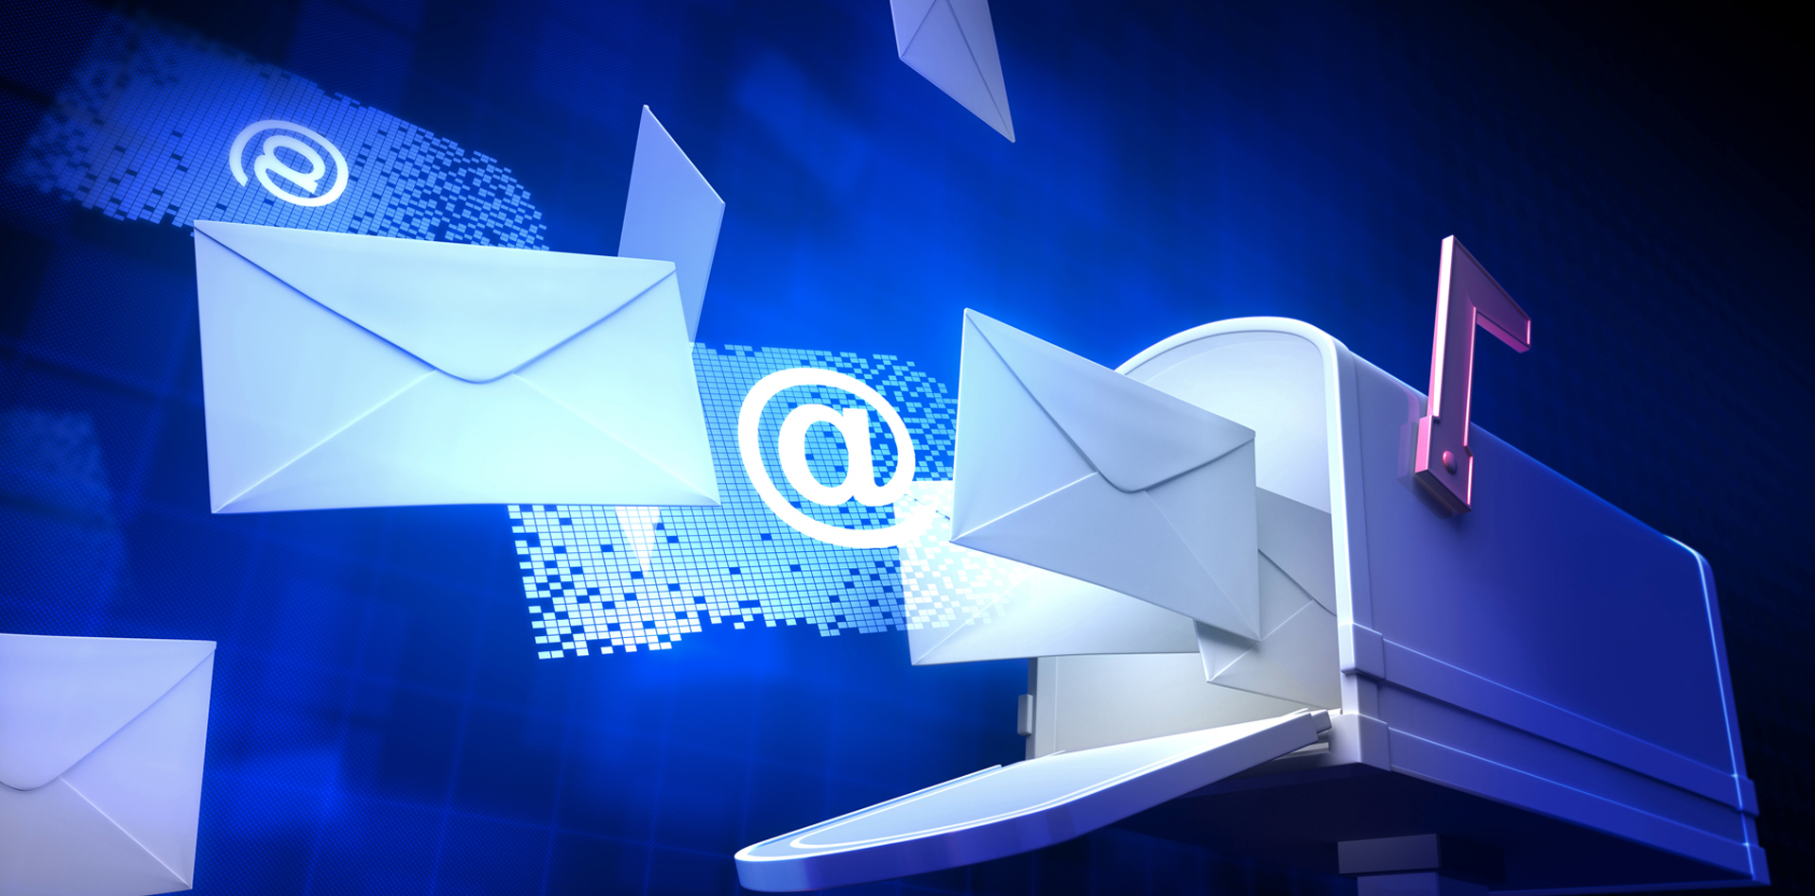

Slide 13
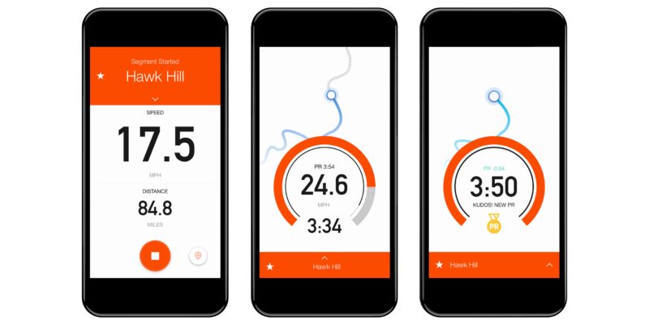

Slide 14
Available state-of-the-art techniques
02
Which technologies ease the implementation ? What are the available techniques and APIs ? Where does GraphQL fit in ?

Slide 15







Related Technologies

Slide 16
Implementation Techniques
PULL
POLLING
LONG-POLLING
PUSH
LIVE QUERIES
SUBSCRIPTIONS

Slide 17
Polling
SERVER
1
1
2
3
4
5
6
7
CLIENT
1
3
5
6
6

Slide 18
Polling
SERVER
1
2
3
CLIENT
1
2
3

Slide 19
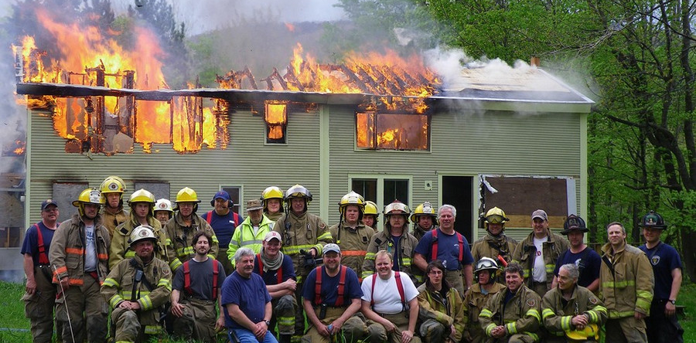

Slide 20
LONG-Polling
SERVER
1
2
CLIENT
1
2

Slide 21
LIVE QUERIES
SERVER
1
2
3
4
5
6
7
8
9
1
CLIENT
1
2
3
4
5
6
7
8
9

Slide 22
SUBSCRIPTIONS
SERVER
1
2
3
4
5
6
7
8
9
1
CLIENT
1
2
4
8
9

Slide 23
What do we actually send to the client ?
{
resourceUrl: https://my-api.beer/9
}
- An additional request is required in order
to retrieve the necessary data about the
resource
{
id: “9”,
title: “Brewmeister Snake Venom”,
“description”: “Brain damage”,
grades: “67.5”,
palletId: “123-24-505”,
...
}
vs
Most probably, additional data that the
client doesn’t need will be sent

Slide 24
What do we actually send to the client ?
{
newNotifications: 18
}
- Sent data varies between clients / subscribers

Slide 25
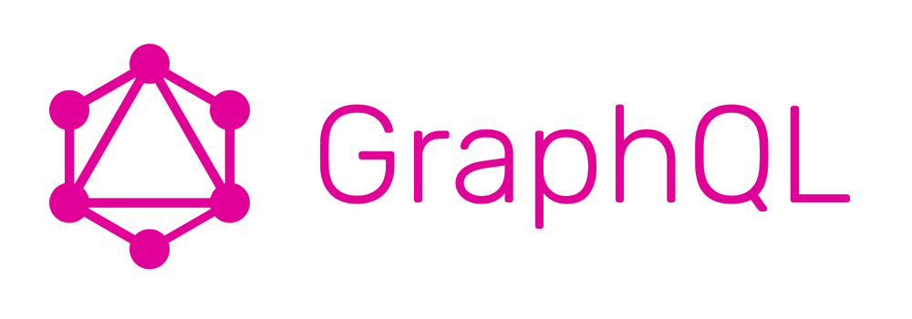

Slide 26
Powering real-time apps using graphql
03
What’s GraphQL ? - General overview of GraphQL features
GraphQL Subscriptions – Implementation examples

Slide 27

HEARING ABOUT A NEW TECHNOLOGY: THE THREE STAGES

Slide 28

1. dismissal
“ One more JavaScript library ? I’m already using jQuery ! “

Slide 29
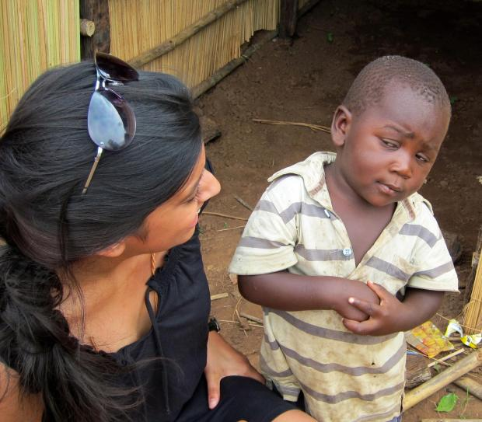
2. INTEREST
“ Hmm.... Maybe I should check this new library I keep hearing about !? “

Slide 30

3. PANIC
“ Omg! I need to learn this library right now or I’ll be completely obsolete ! ”

Slide 31
WHAT IS GRAPHQL ?
Declarative data query language for APIs
Provides a common interface between the CLIENT and the SERVER for fetching and maniputaling data
Client-specified queries
It is not tied to any specific database or storage engine

Slide 32
“WISH-DRIVEN-DESIGN”
{
“emails”: [{
“from”: carl@gmail.com,
“subject”: “Meet-up” ,
“isRead”: “false
}]
}

Slide 33
“WISH-DRIVEN-DESIGN”
{
emails: {
from
subject
isRead
}
}

Slide 34
GRAPHQL QUERY
query {
emails: {
from
subject
isRead
}
}

Slide 35
What the client receives ?
{
“emails”: [{
“from”: iustinian@gmail.com,
“subject”: “Meet-up” ,
“isRead”: “false
}]
}
- The exact form of data that the client has asked for: NO MORE, NO LESS

Slide 36
GRAPHQL MUTATION
mutation {
createPerson(name: “Levi”, age: 9) {
id
}
}

Slide 37
Graphql main concepts
Schema, Type, Field, Directives + Enum, Interfaces, Fragments, etc...
Query, Mutation, Subscription

Slide 38
Graphql subscription
subscription {
importantEmail: {
from
subject
isRead
}
}

Slide 39
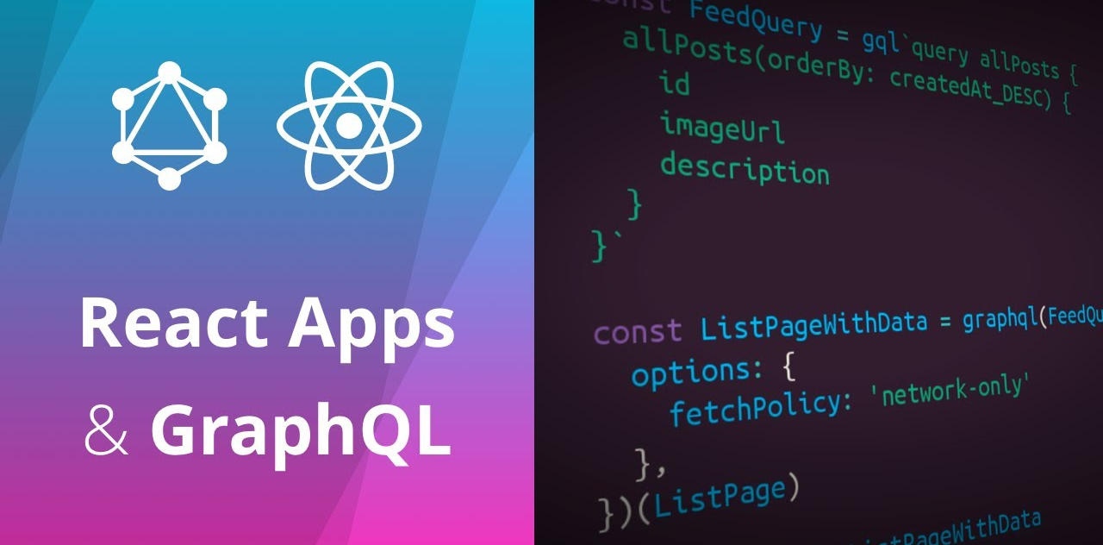

Slide 40
Simple application example
A collection of links of interest added by users related to tech articles
Users can vote on links
Number of votes are updated in real-time
Technology Stack: GraphQL, React, Facebook Relay (Client), Graphcool Platform (Server)

Slide 41
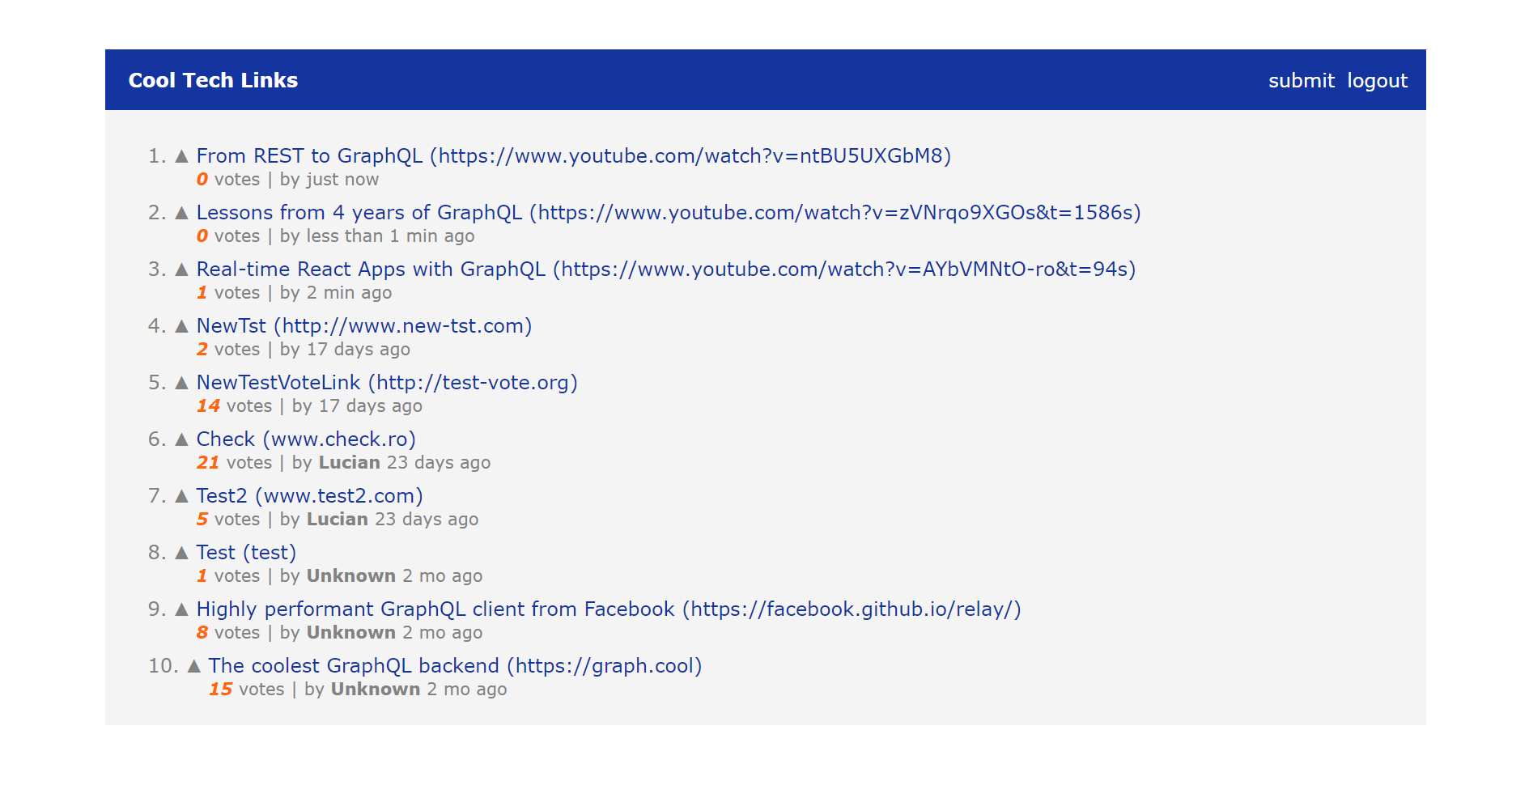
very short demo

Slide 42
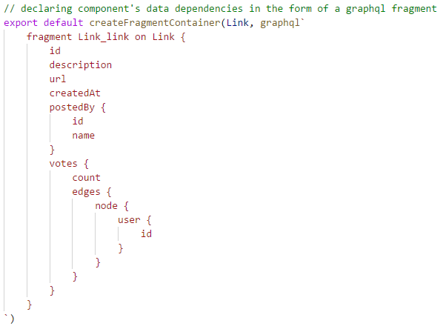
Querying the server for the link list

Slide 43
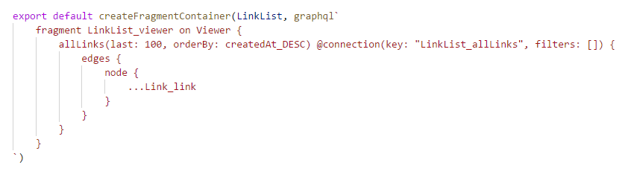
Querying the server for the link list

Slide 44
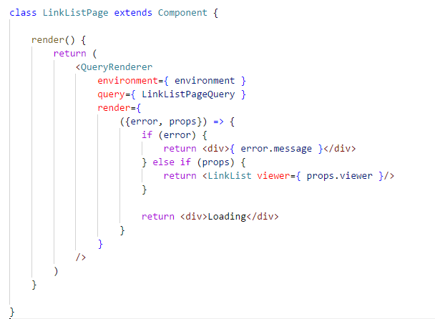
Querying the server for the link list

Slide 45
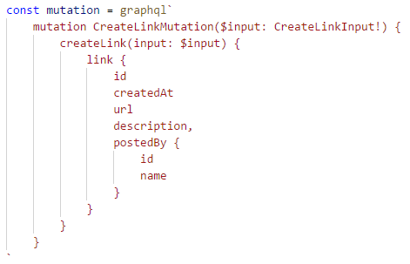
Adding a new link

Slide 46
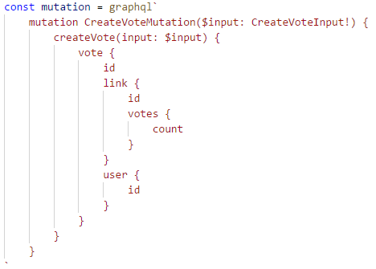
VOTING ON LINK

Slide 47
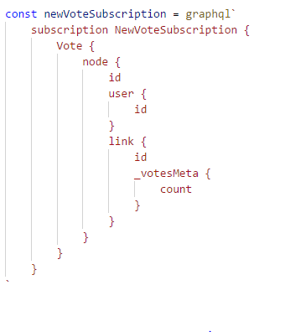
Subscribing for votes

Slide 48

CONCLUSIONS
04
What’s the status at this point ?

Slide 49
What’s the status at this point ?
GraphQL is 5 years old
Feb 2012, originally idea called “SuperGraph” introduced by Nick Schrock, adapted as an implementation for mobile app newsfeed API at Facebook
Nowadays, many different programming languages support GraphQL: C#/.NET, Clojure, Elixir, Erlang, Go, Ruby, Java, JavaScript, PHP, Python, Scala, Ruby

Slide 50
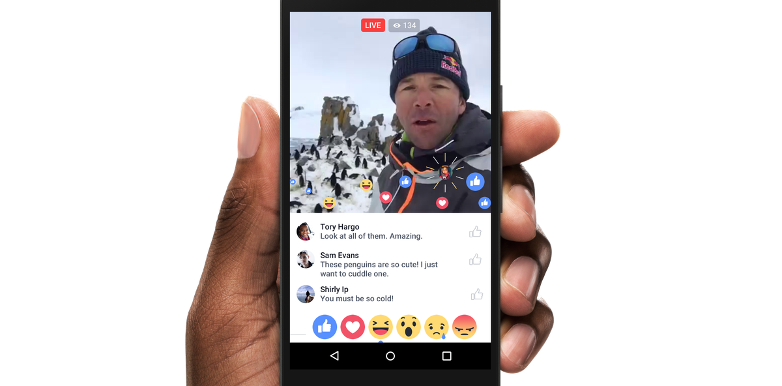

Slide 51
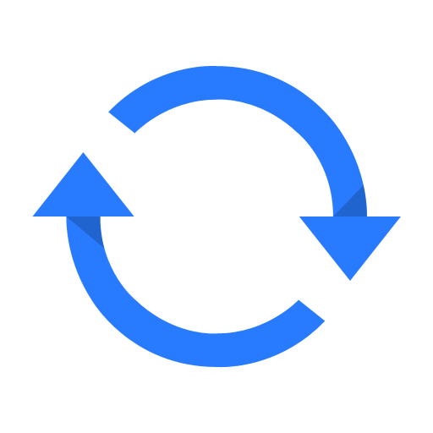
SHORT RECAP
05

Slide 52
Short recap
Real-time apps overview: UX benefits
Available State-of-the-Art techniques
Where does GraphQL fit in
Demo: Implementation example using React, Relay, Graphcool
Conclusions

Slide 53

Disclaimer & REFFERENCES
06

Slide 54
DISCLAIMER & references
Realtime React Apps with GraphQL by Robert Zhu
https://www.youtube.com/watch?v=AYbVMNtO-ro
Lessons from 4 Years of GraphQL by Lee Byron
https://www.youtube.com/watch?v=zVNrqo9XGOs
How to GraphQL – The Fullstack Tutorial for GraphQL
https://www.howtographql.com/
Demo Source Code
https://github.com/luciancostinailenei/graphql-playground/tree/master/realtime-graphql-react-relay

Slide 55
github.com/luciancostinailenei

Slide 56

Questions

Slide 57
Thank you

